Slide 1
Memory Management
SYSTEM DESIGN OS PART 3

Slide 2
MemORY MANAGEMENT
Main Memory
Main memory is the place where programs and information are kept when the processor is effectively utilizing them. Main memory is associated with the processor, so moving instructions and information into and out of the processor is extremely fast. Main memory is also known as RAM (Random Access Memory). This memory is volatile. RAM loses its data when a power interruption occurs.

Slide 3
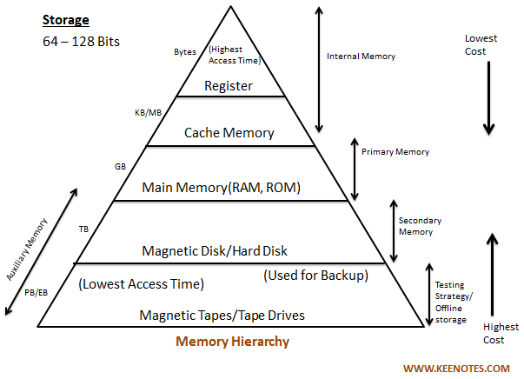
MemORY MANAGEMENT
Memory Hierarchy

Slide 4
MemORY MANAGEMENT
Memory Management
In a multiprogramming computer, the Operating System resides in a part of memory, and the rest is used by multiple processes. The task of subdividing the memory among different processes is called Memory Management.
Need of Memory Management
Allocate and de-allocate memory before and after process execution.
To keep track of used memory space by processes.
To minimize fragmentation issues.
To proper utilization of main memory.
To maintain data integrity while executing of process.

Slide 5
MemORY MANAGEMENT
Logical and Physical Address Space
Logical Address Space: An address generated by the CPU is known as a “Logical Address”. It is also known as a Virtual address. Logical address space can be defined as the size of the process. A logical address can be changed.
Physical Address Space: An address seen by the memory unit (i.e. the one loaded into the memory address register of the memory) is commonly known as a “Physical Address”. A Physical address is also known as a Real address. The set of all physical addresses corresponding to these logical addresses is known as Physical address space. A physical address is computed by MMU. The run-time mapping from virtual to physical addresses is done by a hardware device Memory Management Unit(MMU). The physical address always remains constant.

Slide 6
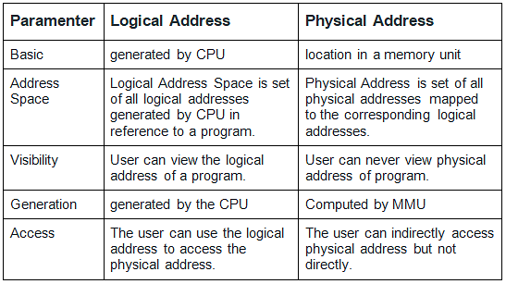
MemORY MANAGEMENT

Slide 7
MemORY MANAGEMENT
Static and Dynamic Loading
Loading a process into the main memory is done by a loader. There are two different types of loading :
Static Loading: Static Loading is basically loading the entire program into a fixed address. It requires more memory space.
Dynamic Loading: The entire program and all data of a process must be in physical memory for the process to execute. So, the size of a process is limited to the size of physical memory. To gain proper memory utilization, dynamic loading is used. In dynamic loading, a routine is not loaded until it is called. All routines are residing on disk in a relocatable load format. One of the advantages of dynamic loading is that the unused routine is never loaded. This loading is useful when a large amount of code is needed to handle it efficiently.

Slide 8
MemORY MANAGEMENT
Static and Dynamic Linking
To perform a linking task a linker is used. A linker is a program that takes one or more object files generated by a compiler and combines them into a single executable file.
Static Linking: In static linking, the linker combines all necessary program modules into a single executable program. So there is no runtime dependency. Some operating systems support only static linking, in which system language libraries are treated like any other object module.
Dynamic Linking: The basic concept of dynamic linking is similar to dynamic loading. In dynamic linking, “Stub” is included for each appropriate library routine reference. A stub is a small piece of code. When the stub is executed, it checks whether the needed routine is already in memory or not. If not available then the program loads the routine into memory.

Slide 9
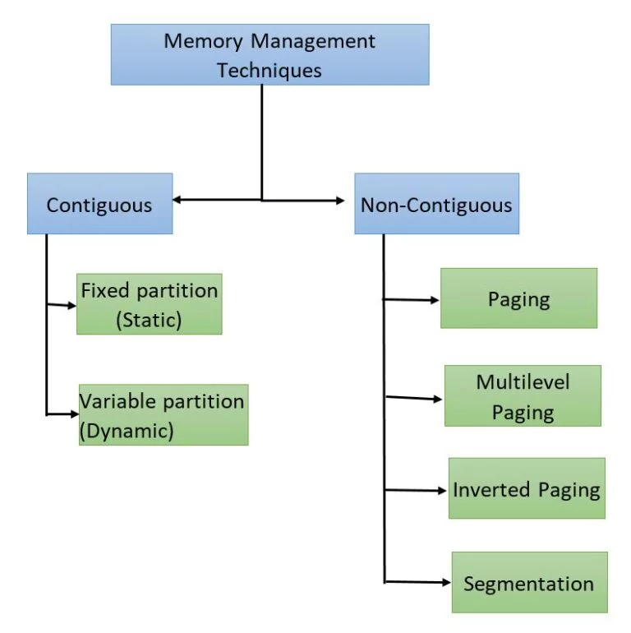
MemORY MANAGEMENT
Memory Allocation Techniques

Slide 10
MemORY MANAGEMENT
Contiguous Memory Allocation Technique:
In this technique, contiguous blocks of memory are allocated to each process. So, whenever a process wants to enter the main memory, continuous segment from the totally empty space to the process based on its size are allocated.
This allocation can be done in two ways:
Fixed-size Partition Scheme
Variable-size Partition Scheme

Slide 11
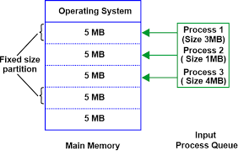
MemORY MANAGEMENT
Fixed-size Partition Scheme:
In this type of contiguous memory allocation technique, each process is allotted a fixed-size continuous block in the main memory. That means there will be continuous blocks of fixed size into which the complete memory will be divided, and each time a process comes in, it will be allotted one of the free blocks. Because irrespective of the size of the process, each is allotted a block of the same size memory space. This technique is also called static partitioning.

Slide 12
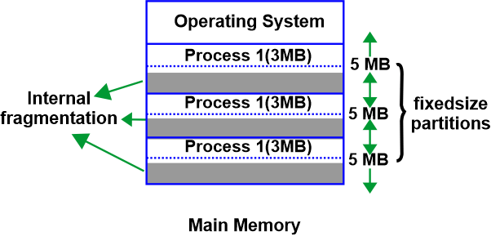
MemORY MANAGEMENT
Fixed-size Partition Scheme:
Advantages:
Supports Multiprogramming
Simple to implement
Tracking of blocks is easy
Disadvantages:
Allocating space to process which have size greater then block size is not possible
size of the blocks decides the degree of multiprogramming
Internal Fragmentation

Slide 13
MemORY MANAGEMENT
Variable-size Partition Scheme
In this type of contiguous memory allocation technique, no fixed blocks or partitions are made in the memory. Instead, each process is allotted a variable-sized block depending upon its requirements.
As the blocks are variable-sized, which is decided as processes arrive, this scheme is also called Dynamic Partitioning.

Slide 14
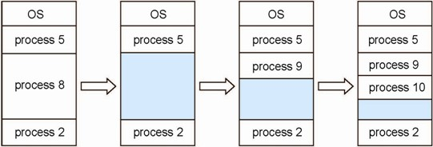
MemORY MANAGEMENT
Variable-size Partition Scheme
Advantages:
No Internal Fragmentation
Degree of multiprogramming is not dependent on block size
Large size processes could be allocated space
Disadvantages:
a variable-size partition scheme is difficult to implement.
It is difficult to keep track of processes and the remaining space in the memory.
External Fragmentation
SOLUTION OF EXTERNAL FRAGMENTATION IS COMPACTION INCASE DYNAMIC PARTITIONS ARE RELOCATATBLE

Slide 15
MemORY MANAGEMENT
Strategies Used for Contiguous Memory Allocation Input Queues
First Fit : the first available free hole fulfil the requirement of the process allocated
Best Fit : In the Best Fit, allocate the smallest hole that is big enough to process requirements. For this, we search the entire list, unless the list is ordered by size.
Worst Fit : In the Worst Fit, allocate the largest available hole to process. This method produces the largest leftover hole.

Slide 16
MemORY MANAGEMENT
Strategies Used for Contiguous Memory Allocation Input Queues
Example: Consider six memory holes of size 200 KB, 400 KB, 600 KB, 500 KB, 300 KB and 250 KB. These partitions need to be allocated to four processes of sizes 357 KB, 210 KB, 468 KB and 491 KB in that order. [Variable size partitioning]
Perform the allocation of processes using-
First Fit Algorithm
Best Fit Algorithm
Worst Fit Algorithm
Find the best allocation strategy

Slide 17
Variable-Size Partitioning: First Fit, Best Fit and Worst Fit
We are given 6 memory holesand 4 processes. We need to allocate the processes in the given order using all three algorithms and then determine the best strategy.
Given data
Memory hole | Size
H1 | 200 KB
H2 | 400 KB
H3 | 600 KB
H4 | 500 KB
H5 | 300 KB
H6 | 250 KB
Processes must be allocated in this order:
Process | Size
P1 | 357 KB
P2 | 210 KB
P3 | 468 KB
P4 | 491 KB
Important rule:Once a process is allocated to a hole, the remaining space in that hole becomes a smaller available hole.
For example, if a 357 KB process is allocated to a 400 KB hole, the remaining hole is:
400-357=43 KB

Slide 18
1. First Fit Algorithm
Rule:Allocate each process to the first available hole that is large enough, scanning from the beginning.
Step 1: Allocate P1 = 357 KB
Hole 400 KB is the first suitable hole.
400-357=43KB
Step 2: Allocate P2 = 210 KB
The first suitable remaining hole is 600 KB.
600-210=390 KB
Step 3: Allocate P3 = 468 KB
The first suitable remaining hole is 500 KB.
500-468=32KB
Step 4: Allocate P4 = 491 KB
No remaining hole is large enough. The largest remaining hole is 390 KB.
Process | Allocated hole | Remaining space
P1 (357 KB) | 400 KB | 43 KB
P2 (210 KB) | 600 KB | 390 KB
P3 (468 KB) | 500 KB | 32 KB
P4 (491 KB) | Not allocated | —
Result:3 out of 4 processes allocated.

Slide 19
2. Best Fit Algorithm
Rule:Allocate each process to the smallest available hole that is large enough.
Step 1: Allocate P1 = 357 KB
The smallest suitable hole is 400 KB.
400-357=43KB
Step 2: Allocate P2 = 210 KB
The smallest suitable hole is 250 KB.
250-210=40KB
Step 3: Allocate P3 = 468 KB
The smallest suitable hole is 500 KB.
500-468=32KB
Step 4: Allocate P4 = 491 KB
The smallest suitable remaining hole is 600 KB.
600-491=109KB
Process | Allocated hole | Remaining space
P1 (357 KB) | 400 KB | 43 KB
P2 (210 KB) | 250 KB | 40 KB
P3 (468 KB) | 500 KB | 32 KB
P4 (491 KB) | 600 KB | 109 KB
Result:All 4 processes are allocated successfully.

Slide 20
3. Worst Fit Algorithm
Rule:Allocate each process to the largest available hole.
Step 1: Allocate P1 = 357 KB
The largest hole is 600 KB.
600-357=243KB
Step 2: Allocate P2 = 210 KB
The largest remaining hole is 500 KB.
500-210=290KB
Step 3: Allocate P3 = 468 KB
Cannot be allocated. The largest remaining hole is 400 KB.
Step 4: Allocate P4 = 491 KB
Cannot be allocated either. The largest remaining hole is still 400 KB.
Process | Allocated hole | Remaining space
P1 (357 KB) | 600 KB | 243 KB
P2 (210 KB) | 500 KB | 290 KB
P3 (468 KB) | Not allocated | —
P4 (491 KB) | Not allocated | —
Result:Only 2 out of 4 processes are allocated.

Slide 21
Best Fit is the winner for this example.
It allocates all four processes by selecting the smallest suitable hole each time.
Conclusion:
For the given memory holes and process sizes, Best Fit is the best allocation strategy because all four processes can be accommodated, whereas First Fit allocates three and Worst Fit allocates only two.
Note that Best Fit is best for this particular example; it is not necessarily the best strategy for every memory-allocation problem.

Slide 22
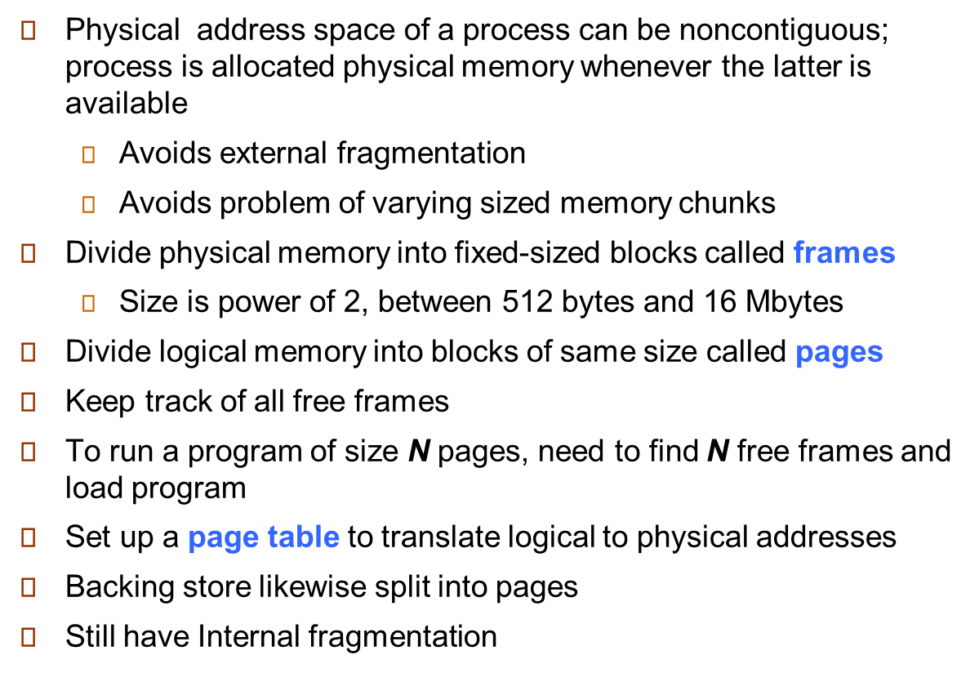
MemORY MANAGEMENT
PAGING

Slide 23
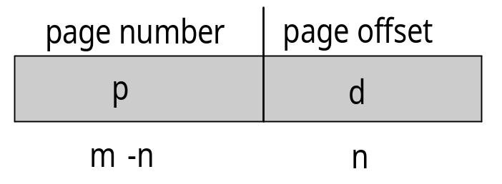
MemORY MANAGEMENT
PAGING
Address generated by CPU is divided into:
  Page number (p) – used as an index into a page table which contains base address of each page in physical memory
  Page offset (d) – combined with base address to define the physical memory address that is sent to the memory unit
  For given logical address space 2^{m} and page size 2^{n}

Slide 24
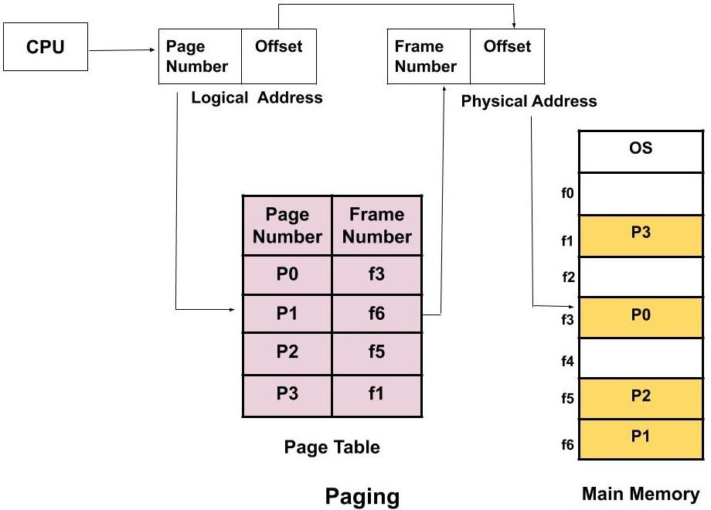
MemORY MANAGEMENT
PAGING

Slide 25
Suppose:
Page size = 1 KB
Logical address = 2500
Page 2 is stored in frame 5
Each address refers to one byte, and pages are numbered from 0.
First, divide the logical address by the page size.
p=(2500/1024)=2
d=2500-(2 x 1024)=452
So the logical address is (page 2, offset 452).
The page table tells us that page 2 is stored in frame 5. Therefore:
Physical address=(5 x 1024)+452
The physical address is 5572.

Slide 26
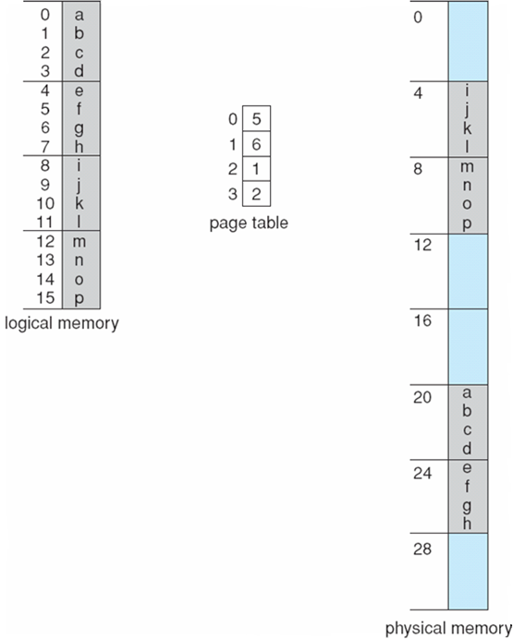
MemORY MANAGEMENT
PAGING EXAMPLE

Slide 27
MemORY MANAGEMENT
PAGING EXAMPLE
QUESTION:
LOGICAL ADDRESS SPACE (LAS) is 128KB, PHYSICAL ADDRESS SPACE (PAS) is 512KB and PAGE SIZE is 16KB [Byte addressable]
CALCULATE FOLLOWING:
Number of Bits of Logical Address (LA)
Number of Bits of Physical Address (PA)
Number of pages in process (LAS)
Number of Frames in memory (PAS)
Page Table Size

Slide 28
MemORY MANAGEMENT
PAGING EXAMPLE
SOLUTION:
Number of Bits of Logical Address (LA)
128KB =128*1024=131072= 2¹⁷ Bytes 17 bits will be required for LA
b) Number of Bits of Physical Address (PA)
512KB =512*1024=524288= 2¹⁹ Bytes 19 bits will be required for PA
c) Number of pages in process (LAS)
128KB/16KB =8 Pages formula= LAS/Page Size 8 pages
d) Number of Frames in memory (PAS)
Page size = Frame size formula = PAS/Frame Size 512/16=32 frames
e) Page Table Size
formula = No of Pages * Page entry size (log (32)) to identify the 32 frames
= 8 * 5
= 40 bits or 5 bytes(40/8)

Slide 29
MemORY MANAGEMENT
PAGING EXAMPLE
Assignment Question I:
GIVEN DATA :
64 MB physical memory
32 bit virtual address space.
page size is 4 KB
Consider the memory as byte addressable.
what is the approximate size of the page table?

Slide 30
Step 1: Calculate the number of pages
A 32-bit virtual address space can address:
2³² bytes =4GB
Page size:
4KB =2^12 bytes
Formula:
Number of pages=Virtual address space/Page size
2³²/2¹²=2²⁰
Therefore,
Number of pages=1,048,576

Slide 31
MemORY MANAGEMENT
PAGING EXAMPLE
Assignment Question II:
GIVEN DATA :
Calculating internal fragmentation
  Page size = 2,048 bytes
  Process size = 72,766 bytes
Consider the memory as byte addressable.

Slide 32
Step 1: Calculate the number of pages required
Formula:
Number of pages= Process size/Page size
Substitute the values:
Pages=72766/2048
=35.53
Since we cannot allocate a fraction of a page:
Number of pages=36
Step 2: Calculate total allocated memory
Each page contains 2,048 bytes.
Allocated memory=36 x 2048
73728 bytes
Step 3: Calculate internal fragmentation
Formula:
Internal Fragmentation=Allocated memory-Process size
Substitute the values:
=73728-72766=962 bytes

Slide 33
MemORY MANAGEMENT
PAGING EXAMPLE
Assignment Question III:
GIVEN DATA :
Calculate the size of memory if its address consists of 22 bits and the memory is 2-byte addressable.

Slide 34
Step 1: Understand 22-bit addressing
An address consisting of 22 bits can represent:
2²²=4,194,304 addresses
Step 2: Understand 2-byte addressability
Each address refers to 2 bytes of memory.
Therefor:
Memory size=2²² x 2
=2^{22 x} 2¹=2²³ bytes
Step 3: Convert bytes to MB
2²³=8,388,608 bytes
Since 1 MB=2²⁰ bytes
2^{23/}2²⁰=2³=8 MB

Slide 35
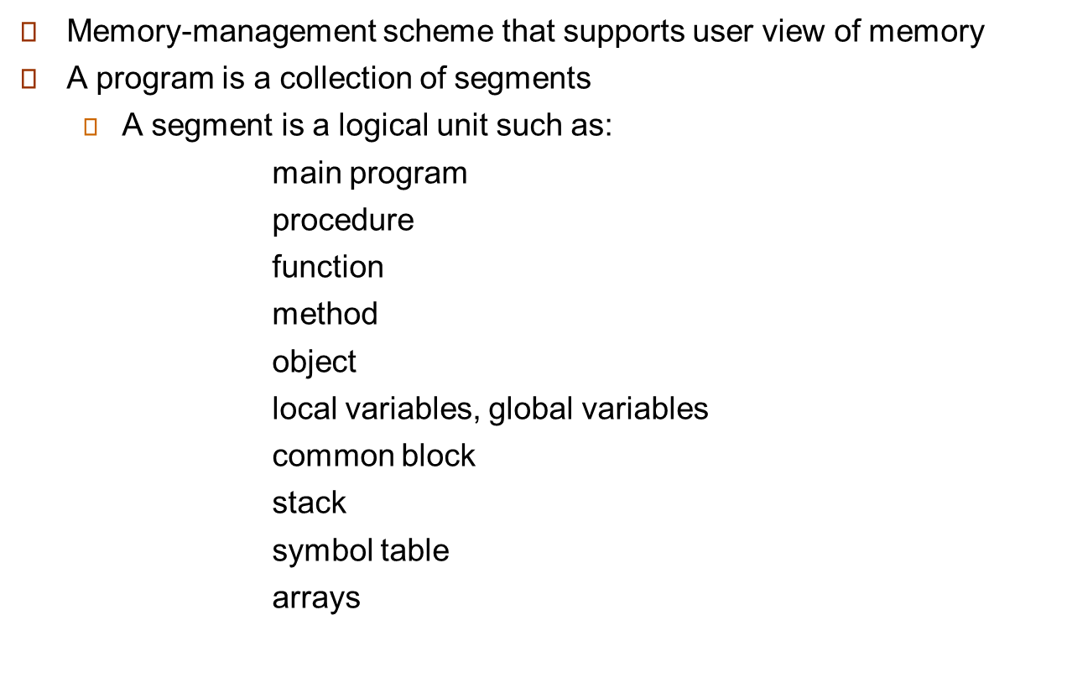

MemORY MANAGEMENT
Segmentation

Slide 36
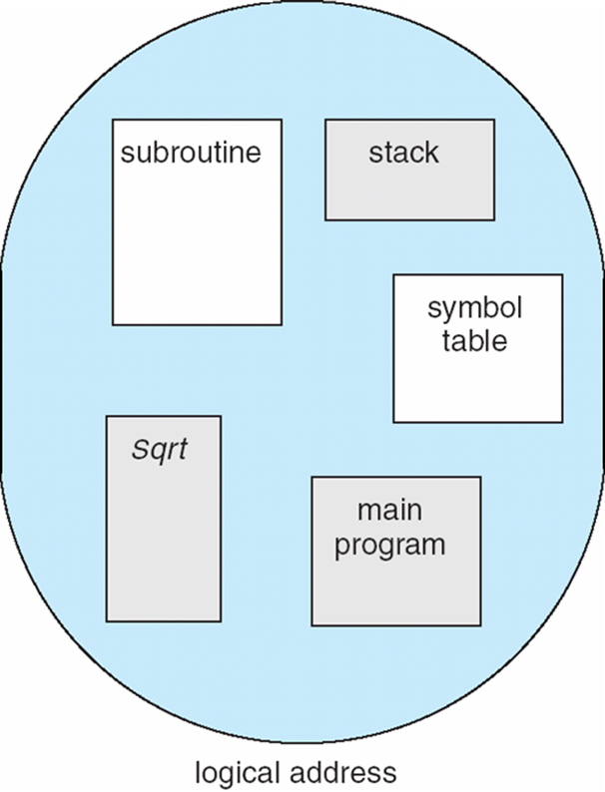
MemORY MANAGEMENT
Segmentation: User view of Program
This slide illustrates how a programmer views a program as separate logical units rather than one continuous block.
Imagine a program containing:
Segment 0: Code
Instructions to execute
Segment 1: Data
Variables and stored values
Segment 2: Stack
Function calls and local variables
Segment 3: Heap
Dynamically allocated memory
Each segment represents a meaningful part of the program. The operating system can map these segments to different locations in physical memory.

Slide 37
MemORY MANAGEMENT
Segmentation: User view of Program
1
4
1
3
2
2
4
3
user space
physical memory space

Slide 38
MemORY MANAGEMENT
Segmentation:
Logical address consists of a two tuple:
<segment-number, offset>,
Segment table – maps two-dimensional physical addresses; each table entry has:
  base – contains the starting physical address where the segments reside in memory
  limit – specifies the length of the segment
Segment-table base register (STBR) points to the segment table’s location in memory
Segment-table length register (STLR) indicates number of segments used by a program;
segment number s is legal if s < STLR

Slide 39
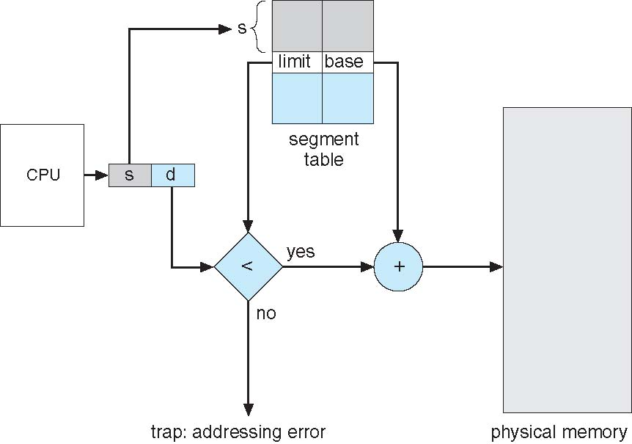
MemORY MANAGEMENT
Segmentation Hardware:

Slide 40
MemORY MANAGEMENT
Virtual Memory Concept: (On demand Paging)
Processes deal with virtual memory – they have the
illusion that a very large address space is available to
them
There is only a limited amount of physical memory that is
shared by all processes – a process places part of its
virtual memory in this physical memory and the rest is
stored on disk (called swap space)
Thanks to locality, disk access is likely to be uncommon
The hardware ensures that one process cannot access
the memory of a different process

Slide 41

MemORY MANAGEMENT
Virtual Memory Concept:

Slide 42
TERMS AND MEANINGS
Effective Access Time (EAT) with a Translation Lookaside Buffer (TLB)
EAT = h(t + m) + (1 − h)[t + (L + 1)m]
EAT — Effective Access Time
Average time needed to access memory.
h — TLB Hit Ratio
Fraction / percentage of lookups found in the TLB.
t — TLB Lookup Time
Time taken to search the TLB.
m — Memory Access Time
Time for one access to main memory.
L — Page-Table Levels
Number of levels in the page table.
TLB — Translation Lookaside Buffer
A small, fast cache of recent address translations.
Quick memory tip: hit = translation found in TLB; miss = page table must be checked.

Slide 43
EFFECTIVE ACCESS TIME (EAT)
How fast is memory access when a Translation Lookaside Buffer (TLB) is used?
EAT = h(t + m) + (1 − h)[t + (L + 1)m]
Hit case: t + m | Miss case: t + (L + 1)m
WHAT THE SYMBOLS MEAN
• h = TLB hit ratio
• t = TLB lookup time
• m = one memory access time
• L = number of page-table levels
CASE EXAMPLE
Given: t = 20 ns, m = 100 ns, h = 80% = 0.8, L = 1
TLB hit time = t + m = 20 + 100 = 120 ns
TLB miss time = t + (L + 1)m = 20 + (1 + 1)100 = 220 ns
EAT = 0.8(120) + 0.2(220) = 96 + 44
EAT = 140 ns
Remember: a TLB hit avoids extra page-table memory accesses; a miss requires them.

Slide 44
MemORY MANAGEMENT
Virtual Memory Concept:
Effective Memory Access Time = Hit Ratio of TLB * { Access Time of TLB + Access Time of Memory} + Miss Ratio of TLB * { Access Time of TLB + (L+1) * Access Time of Memory}
Where L stands for Number of levels of page table

Slide 45
MemORY MANAGEMENT
Numerical on EAT
Consider a single level paging scheme with a TLB. Assume no page fault occurs. It takes 20 ns to search the TLB and 100 ns to access the physical memory. If TLB hit ratio is 80%, the effective memory access time is _______ ns.

Slide 46
MemORY MANAGEMENT
Numerical on EAT
Solution:
Effective Access Time
= 0.8 x { 20 ns + 100 ns } + 0.2 x { 20 ns + (1+1) x 100 ns }
= 0.8 x 120 ns + 0.2 + 220 ns
= 96 ns + 44 ns
= 140 ns
Thus, effective memory access time = 140 ns.

Slide 47
MemORY MANAGEMENT
PAGE REPLACEMENT ALGORITHMS
Page Fault: A page fault happens when a running program accesses a memory page that is mapped into the virtual address space but not loaded in physical memory. Since actual physical memory is much smaller than virtual memory, page faults happen. In case of a page fault, Operating System might have to replace one of the existing pages with the newly needed page. Different page replacement algorithms suggest different ways to decide which page to replace. The target for all algorithms is to reduce the number of page faults.

Slide 48
MemORY MANAGEMENT
Page Replacement Algorithms
FIFO
LRU
Optimal Page replacement

